Slide 1
Lab 5 , 6

Slide 2
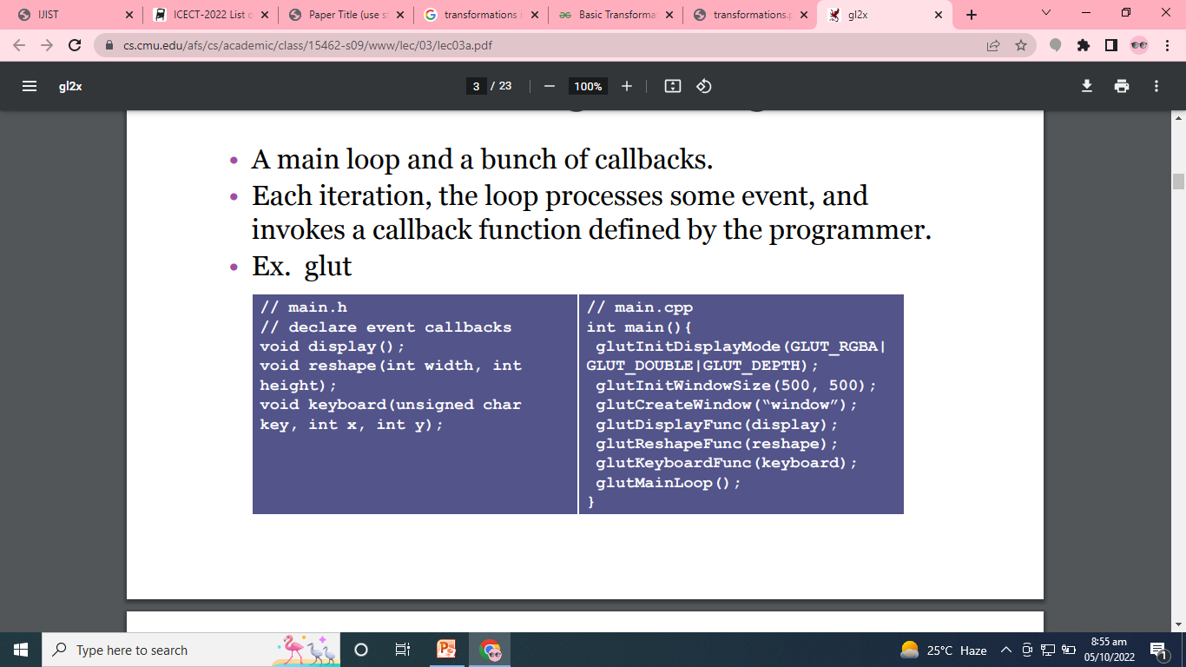

Slide 3
Lets summarize the previous lab tasks about transformation.

Slide 4
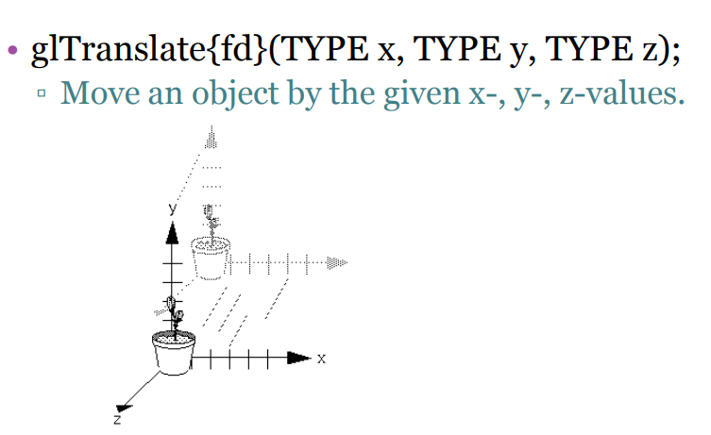

Slide 5
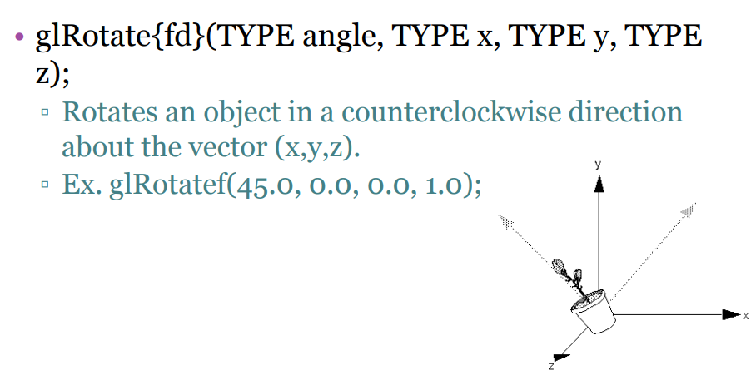

Slide 6
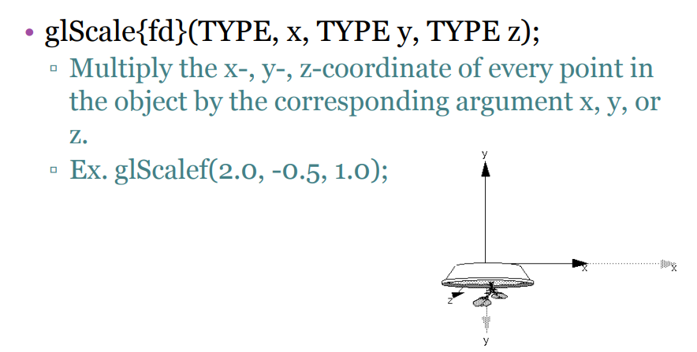

Slide 7
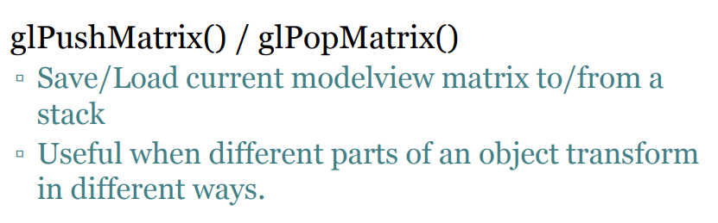

Slide 8
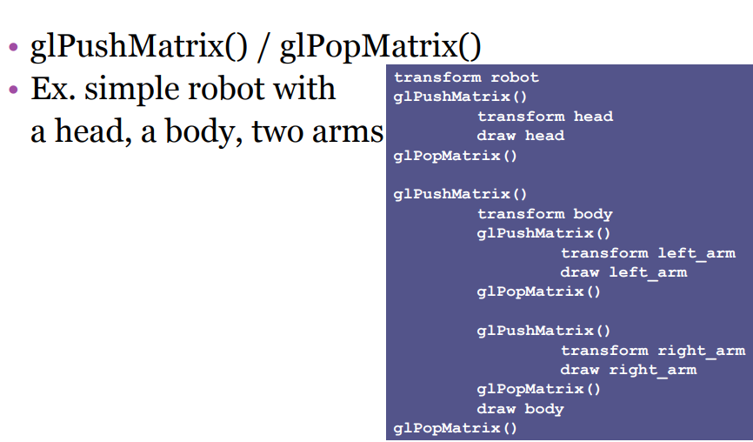

Slide 9
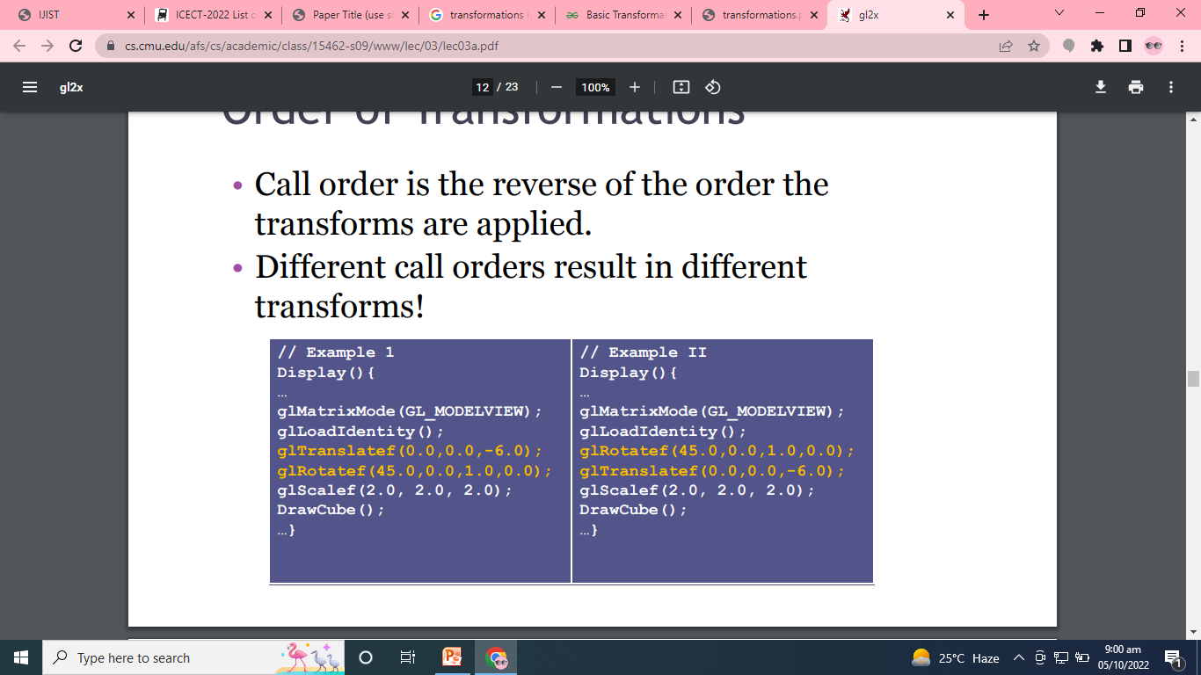
Order of Transformation

Slide 10
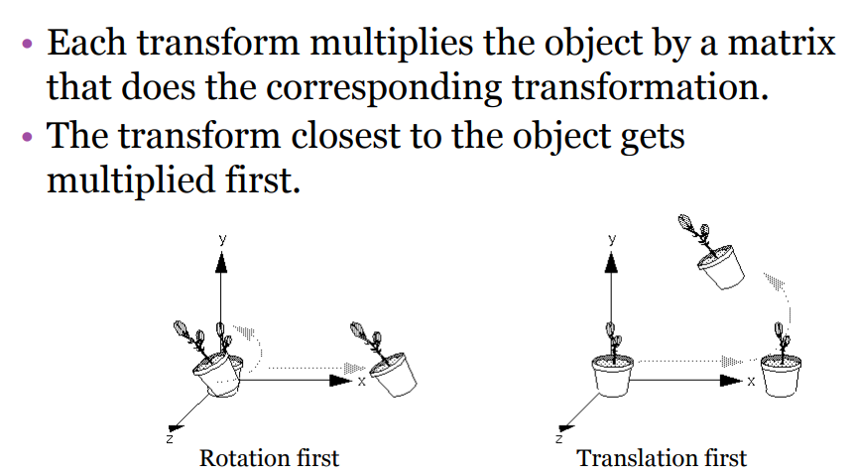

Slide 11
LAB TASK 3
Create the following drawings:
The objects must be created based on the following conditions.
Use Transformations( create a single basic objects )
Rotate
Translate
Scale

Slide 12

Do This Task: RING TOWER
NOTE: The Edges of sides can be square

Slide 13
LAB 4

Slide 14
EVENT HANGLING

Slide 15
void display()
{ glClear(GL_COLOR_BUFFER_BIT);
glFlush(); }
void mymousefunc(int button, int state, intx, int y)
{
if (button == GLUT_LEFT_BUTTON && state == GLUT_DOWN)
{ drawdot(x, 480-y);
glFlush(); }
else if (button == GLUT_RIGHT_BUTTON && state == GLUT_DOWN)
{ exit(-1); }
}

Slide 16
void drawdot(int x, int y)
{
glBegin(GL_POINTS);
glVertex2i(x, y);
glEnd();
glFlush;
}
int main(int argc, char** argv)
{
glutDisplayFunc(display);
glutMouseFunc(mymousefunc);
}

Slide 17
int screenwidth = 640; int screenheight = 480;

Slide 18
LAB 5
Viewport Capturing and creation
Double Viewport Creation
Window to Viewport mapping Algorithm creation

Slide 19
Program to capture the create a viewport in the output window.
#include <GL/glut.h> void mydisplay () { glClearColor(100, 100, 0, 0); glClear(GL_COLOR_BUFFER_BIT); glViewport(0, 0, 500, 500); glMatrixMode(GL_PROJECTION); glLoadIdentity(); gluOrtho2D(-500.0, 500.0, -500.0, 500.0); glColor3f(0, 0, 1); glRectf(0.0, 0.0, 500.0, 500.0); glutSwapBuffers(); }
int main(int argc, char ** argv) { glutInit(&argc, argv); glutInitDisplayMode(GLUT_RGB | GLUT_DOUBLE); glutInitWindowSize(500, 500); glutCreateWindow(“VP”); glutDisplayFunc(mydisplay); glutKeyboardFunc(keyboard); glutMainLoop(); return 0; }

Slide 20
Two Viewports
void draw() { glClearColor( 100, 100, 0, 0 ); glClear ( GL_COLOR_BUFFER_BIT ); glViewport(0,0,250,250); glMatrixMode(GL_PROJECTION); glLoadIdentity(); gluOrtho2D(0.0,50.0,-10.0,40.0); glRectf(0.0,0.0,10.0,30.0); glViewport(250,250,250,250); glMatrixMode(GL_PROJECTION); glLoadIdentity(); gluOrtho2D(0.0,50.0,-10.0,40.0); glColor3f( 1, 0, 0 ); glRectf(0.0,0.0,10.0,30.0); glutSwapBuffers(); }

